Slide 1
Statistical Analysis and Visualization with Python bloch carlo

Slide 2
Agenda
Introduction
Data Generation
Descriptive statistics
Data Visualization
Correlation analysis
Inferential statistics
Final considerations

Slide 3

Introduction
This project aims to perform statistical analysis and data visualization using Python, generating a synthetic dataset, performing descriptive and inferential statistics, and visualizing the results using Matplotlib and Seaborn.
Deliverables are a presentation summarizing your findings, visualizations, and interpretations addressing the technical questions provided.

Slide 4

Data generation
Use Numpy to create a dataset with 1000 samples
The dataset should include the following columns: Age, Height, Weight, Gender, and Income.
Age: Normally distributed with a mean of 35 and a standard deviation of 10
Height: Normally distributed with a mean of 170 cm and a standard deviation of 15 cm
Weight: Normally distributed with a mean of 70 kg and a standard deviation of 10 kg
Gender: Randomly assigned with 50% probability for 'Male' and 'Female'
Income: Normally distributed with a mean of 50,000 and a standard deviation of 15,000

Slide 5
Inferential Statistics

Slide 6
Descriptive Statistics
Basic descriptive statistics
Calculate mean, median, standard deviation, and variance for Age, Height, Weight, and Income
Calculate the mode for Gender.

Slide 7
DATA VISUALIZATION
Results following

Slide 8
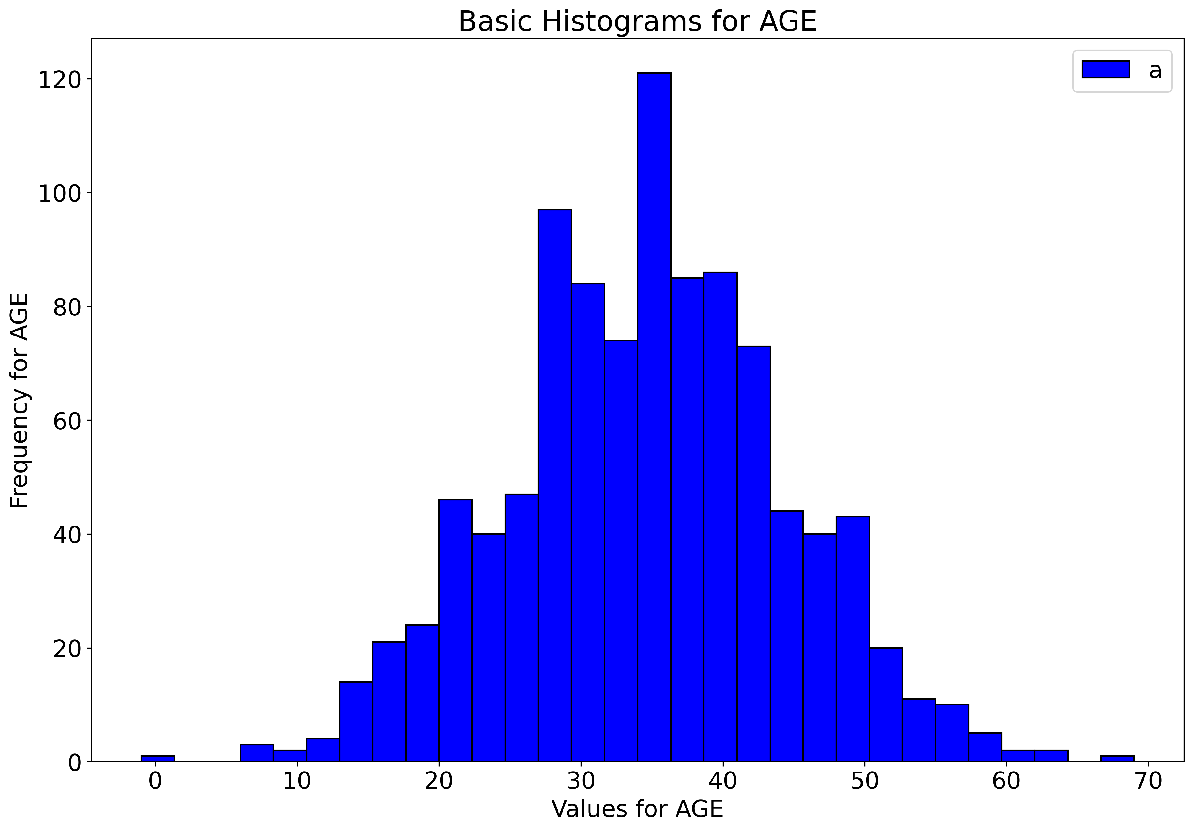
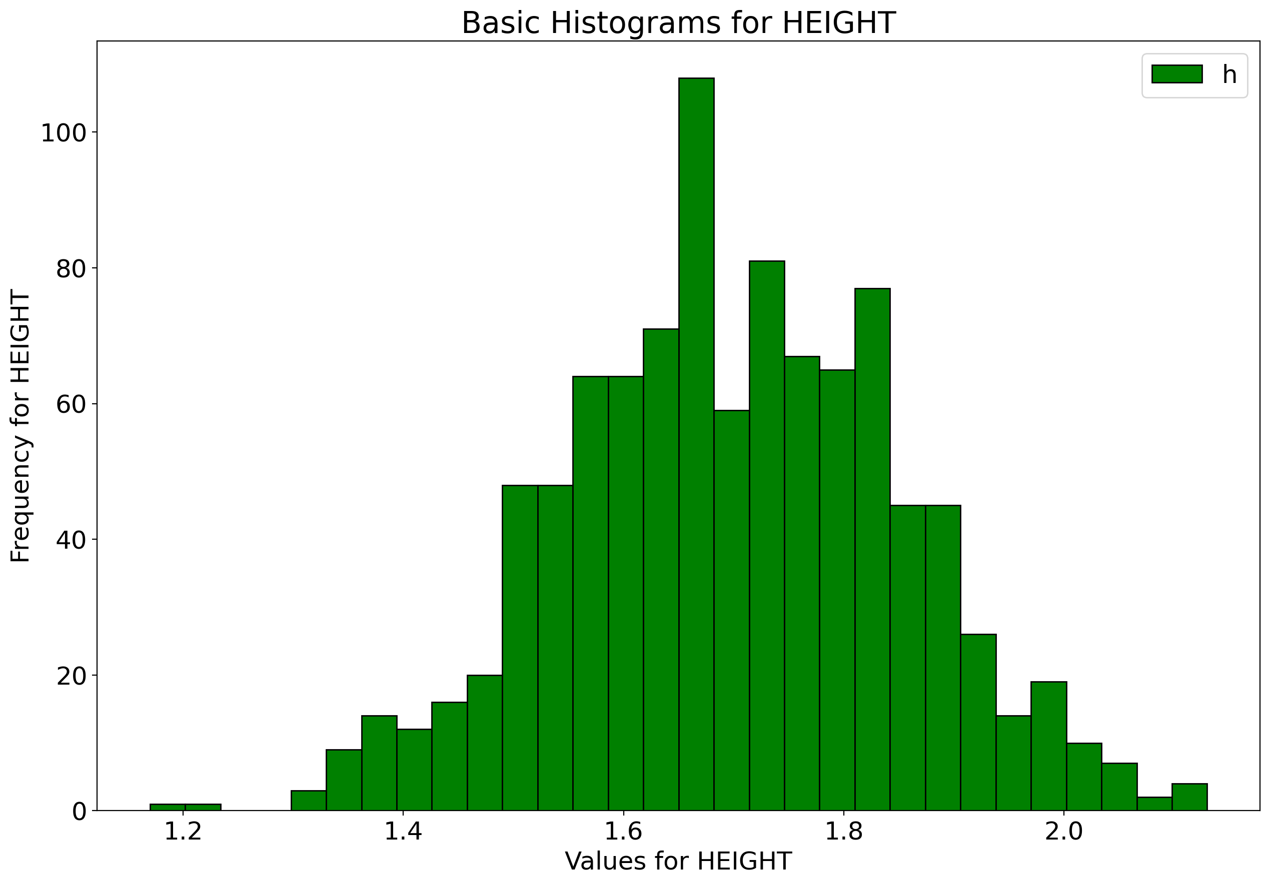
Age, height histograms

Slide 9
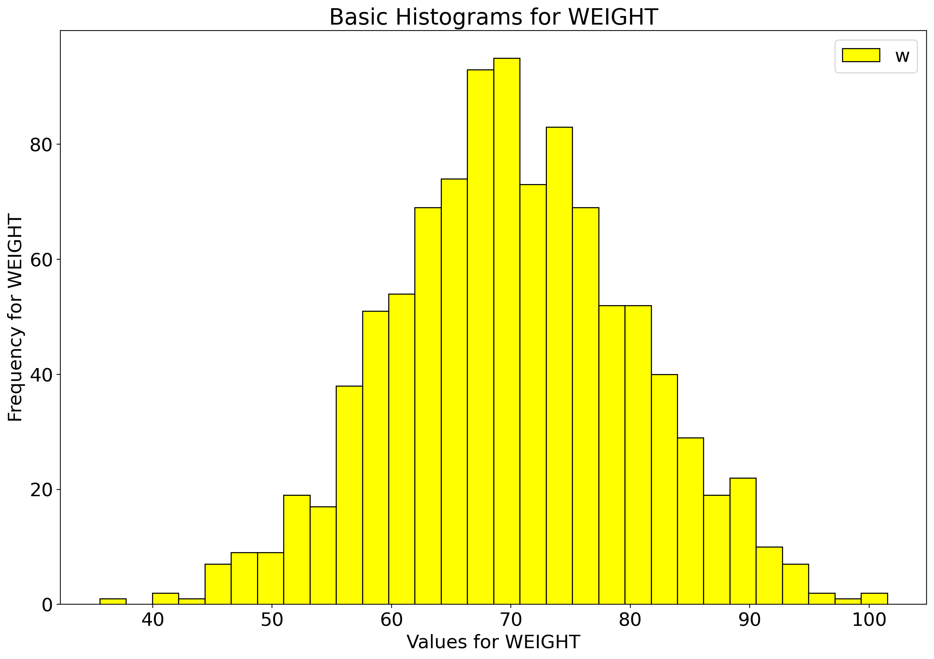
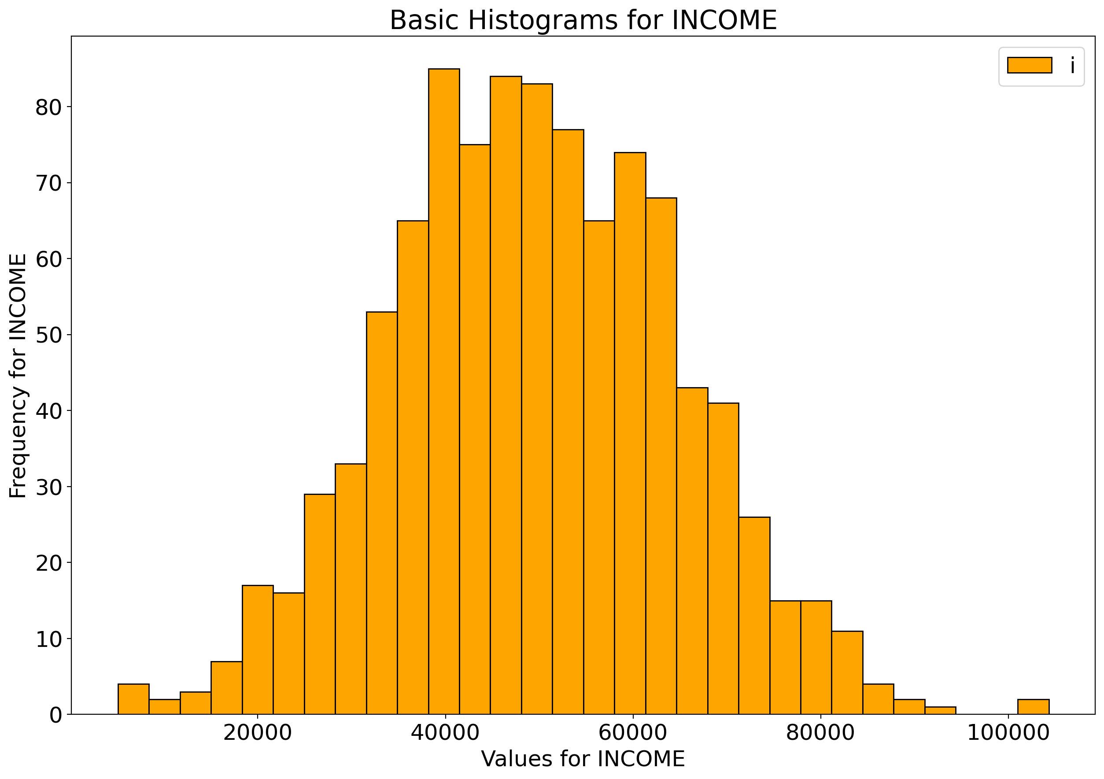
weight, income histograms

Slide 10
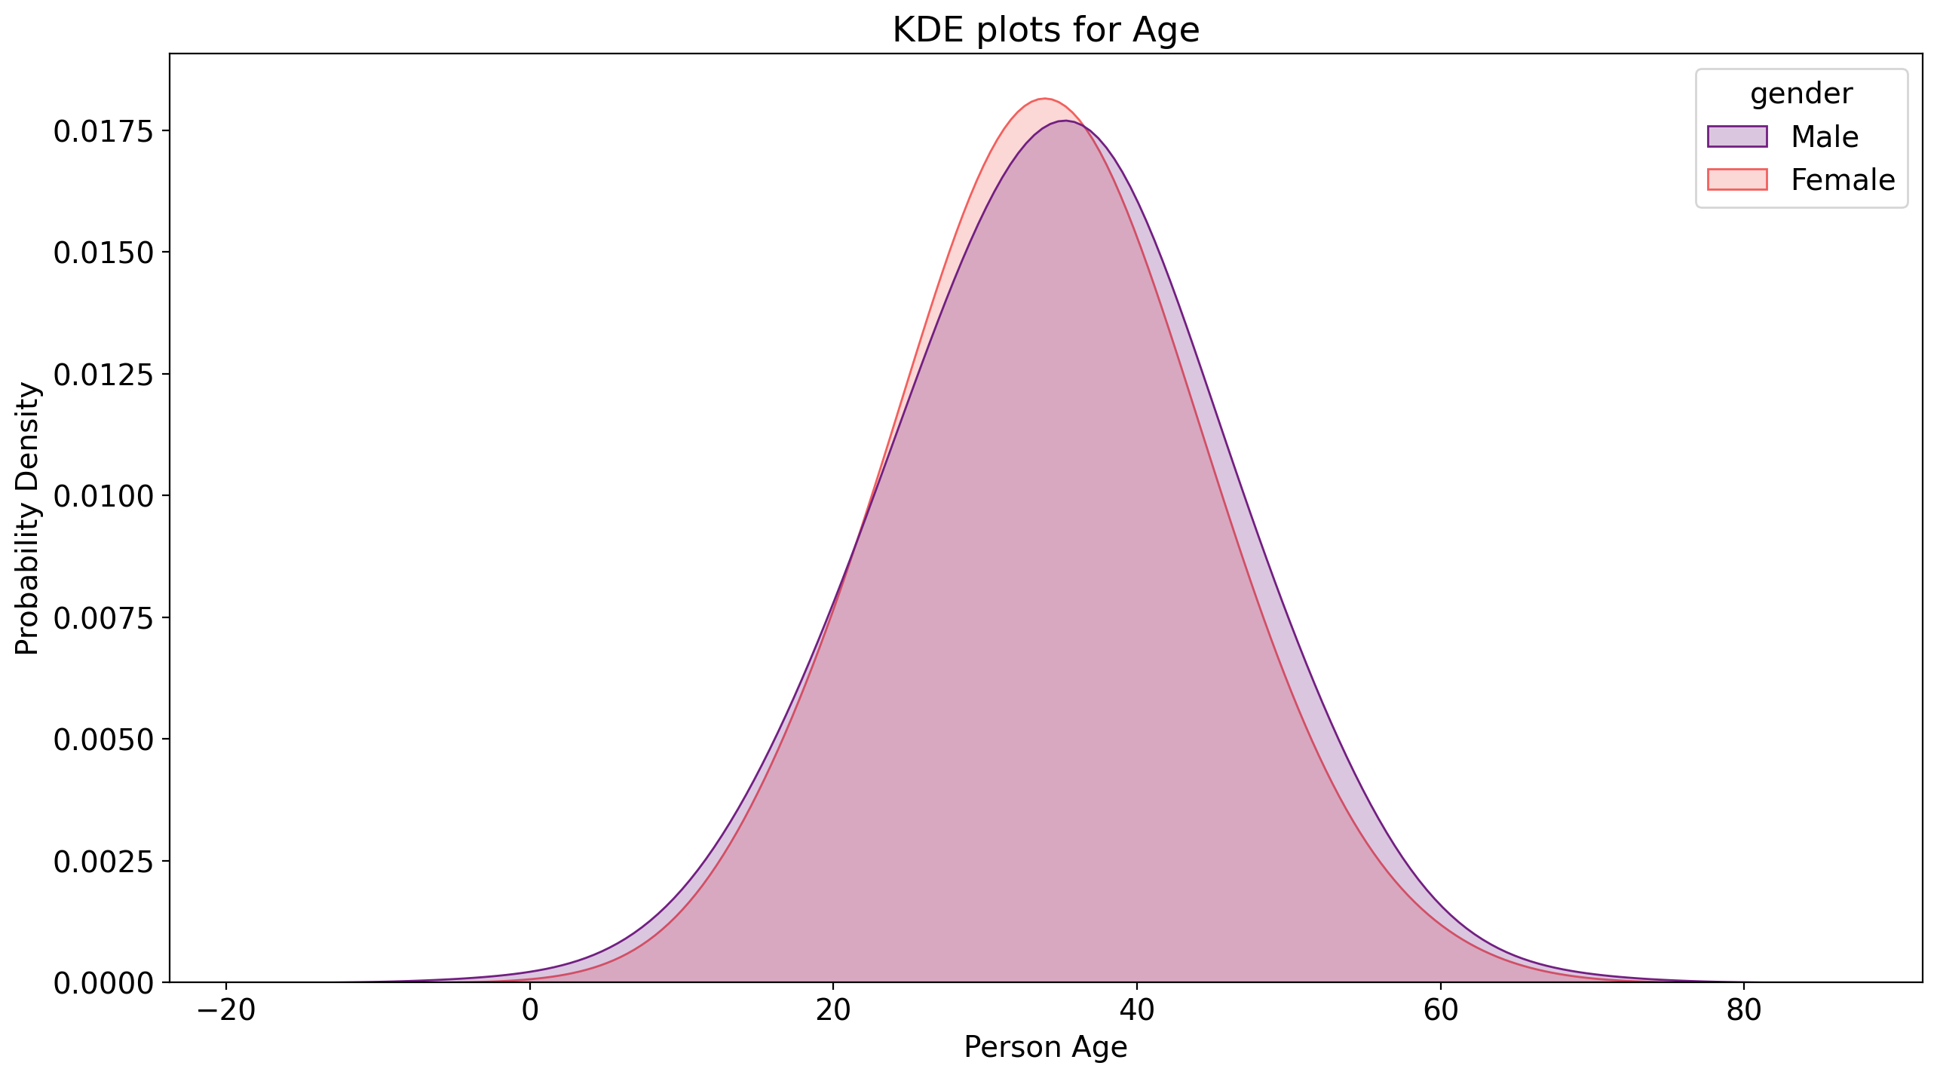
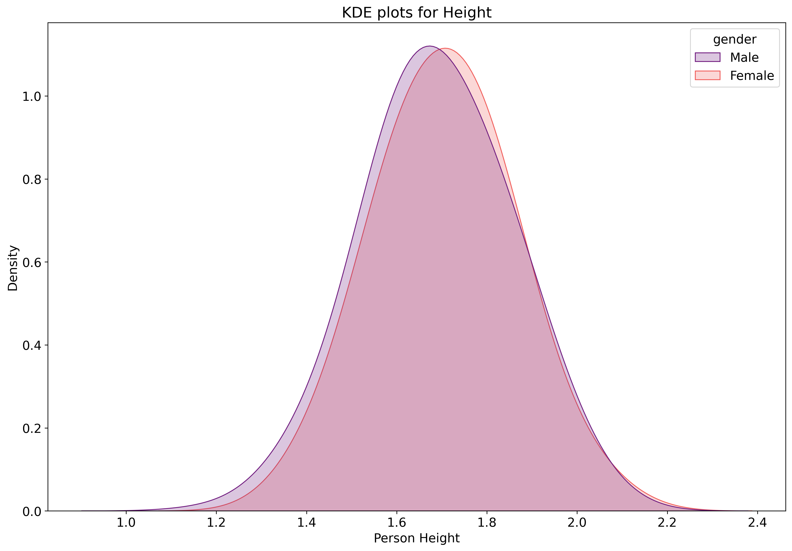
KDE plots

Slide 11
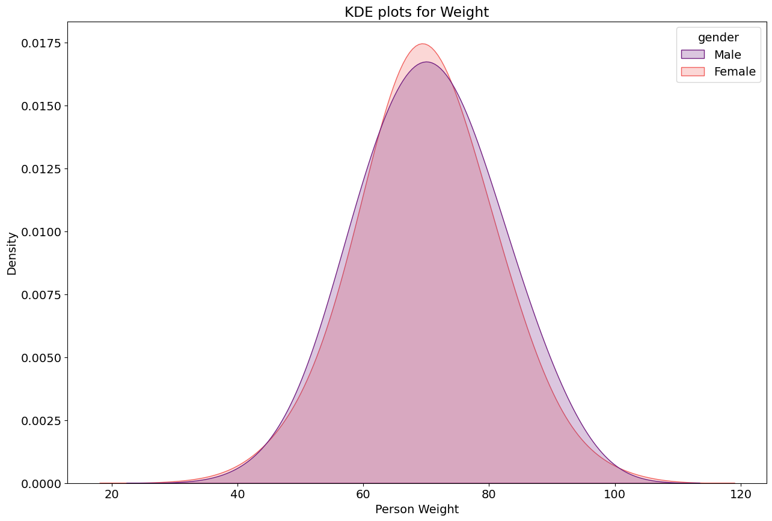
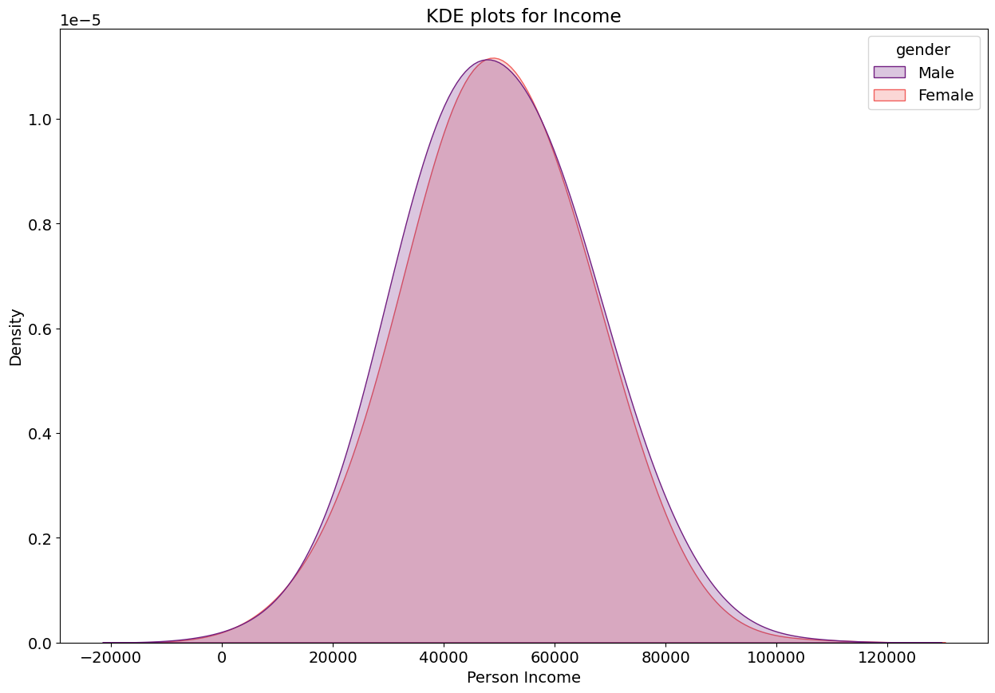
KDE plots

Slide 12
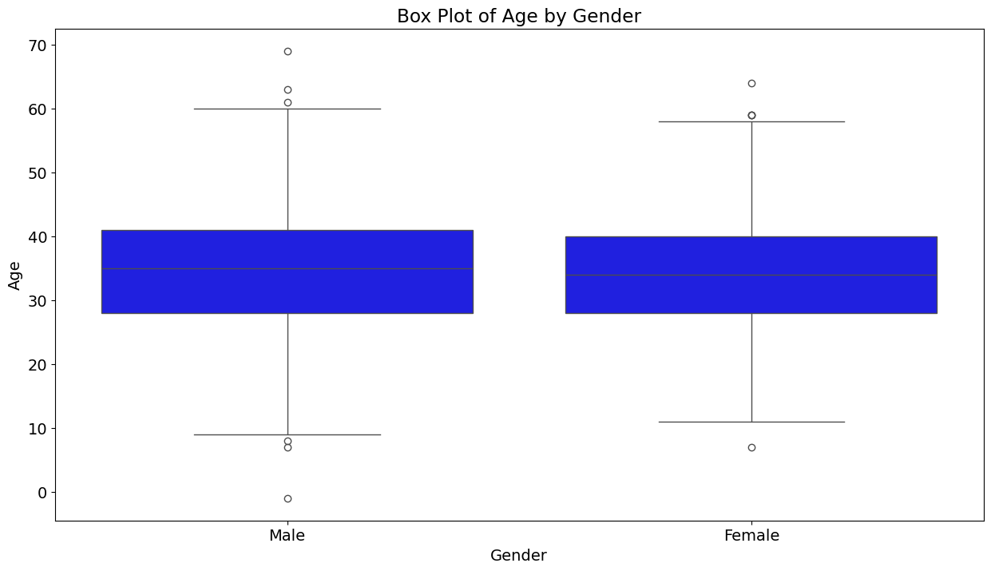
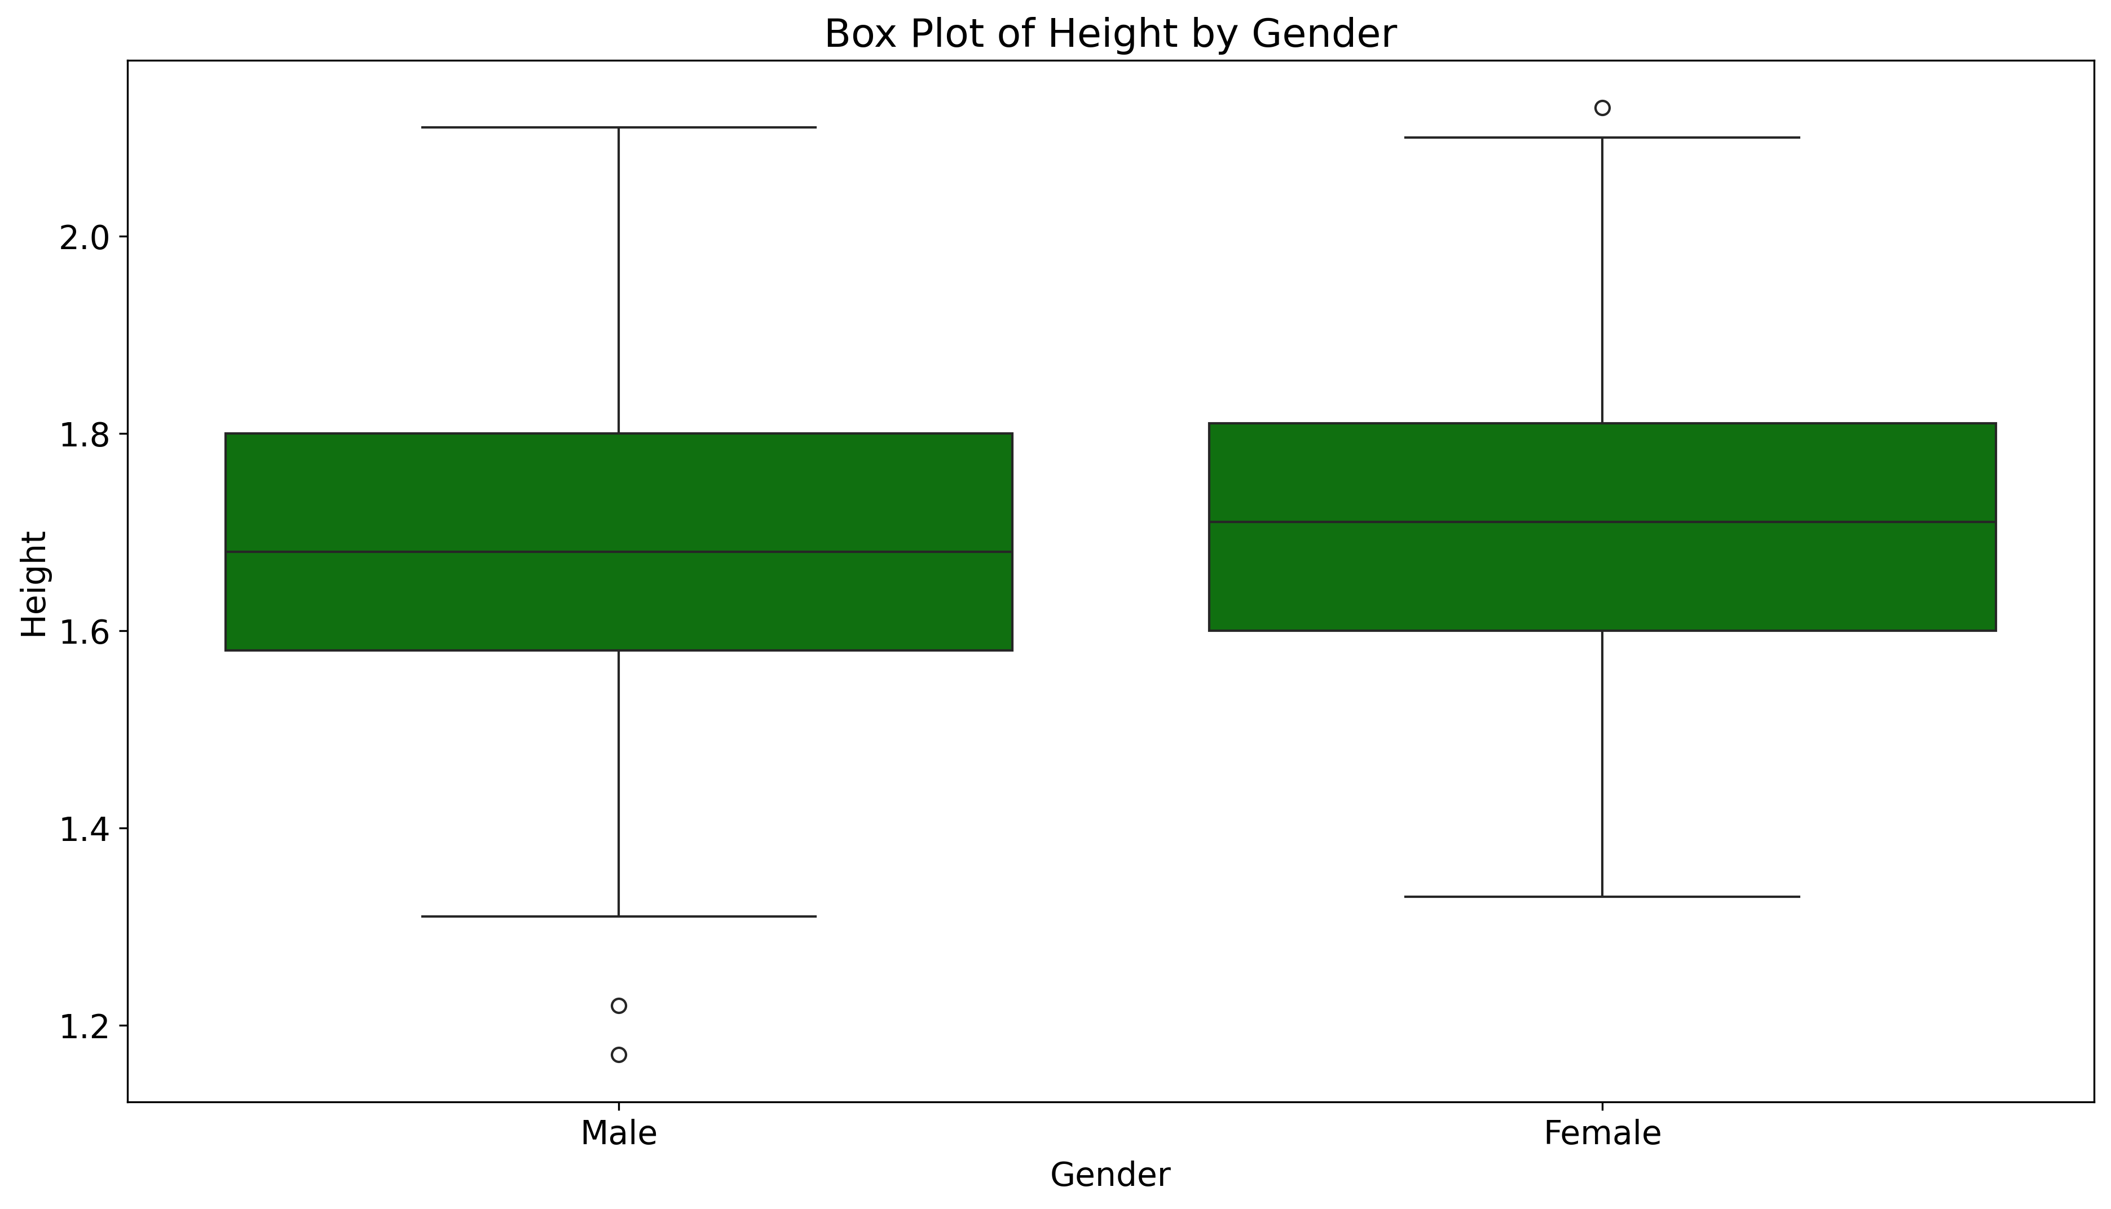
BAR plots – highlighting outliers

Slide 13
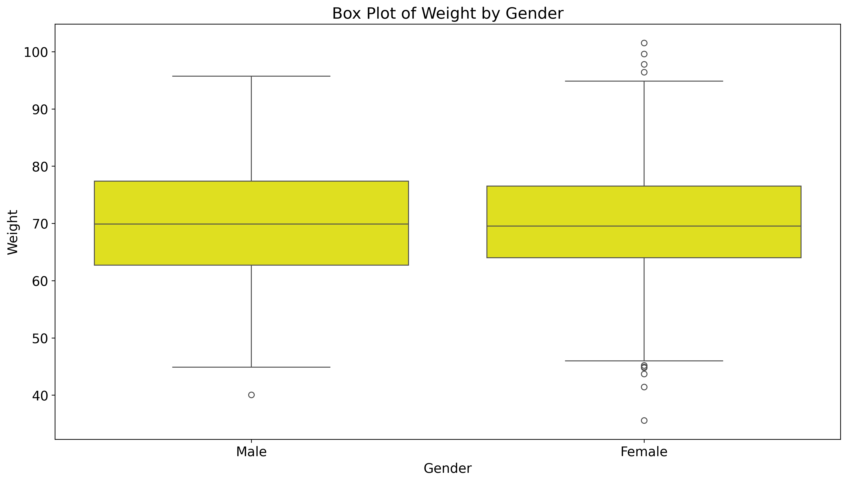
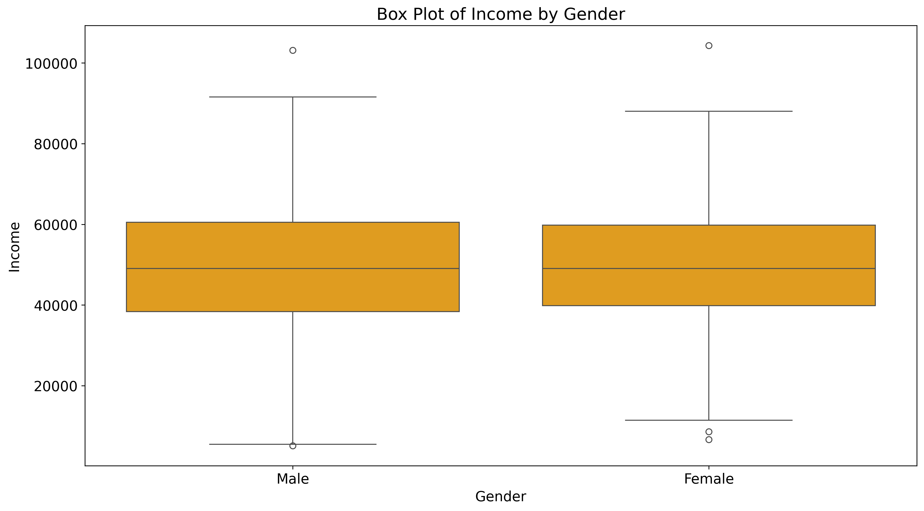
BAR plots – highlighting outliers

Slide 14
Correlation Analysis

Slide 15
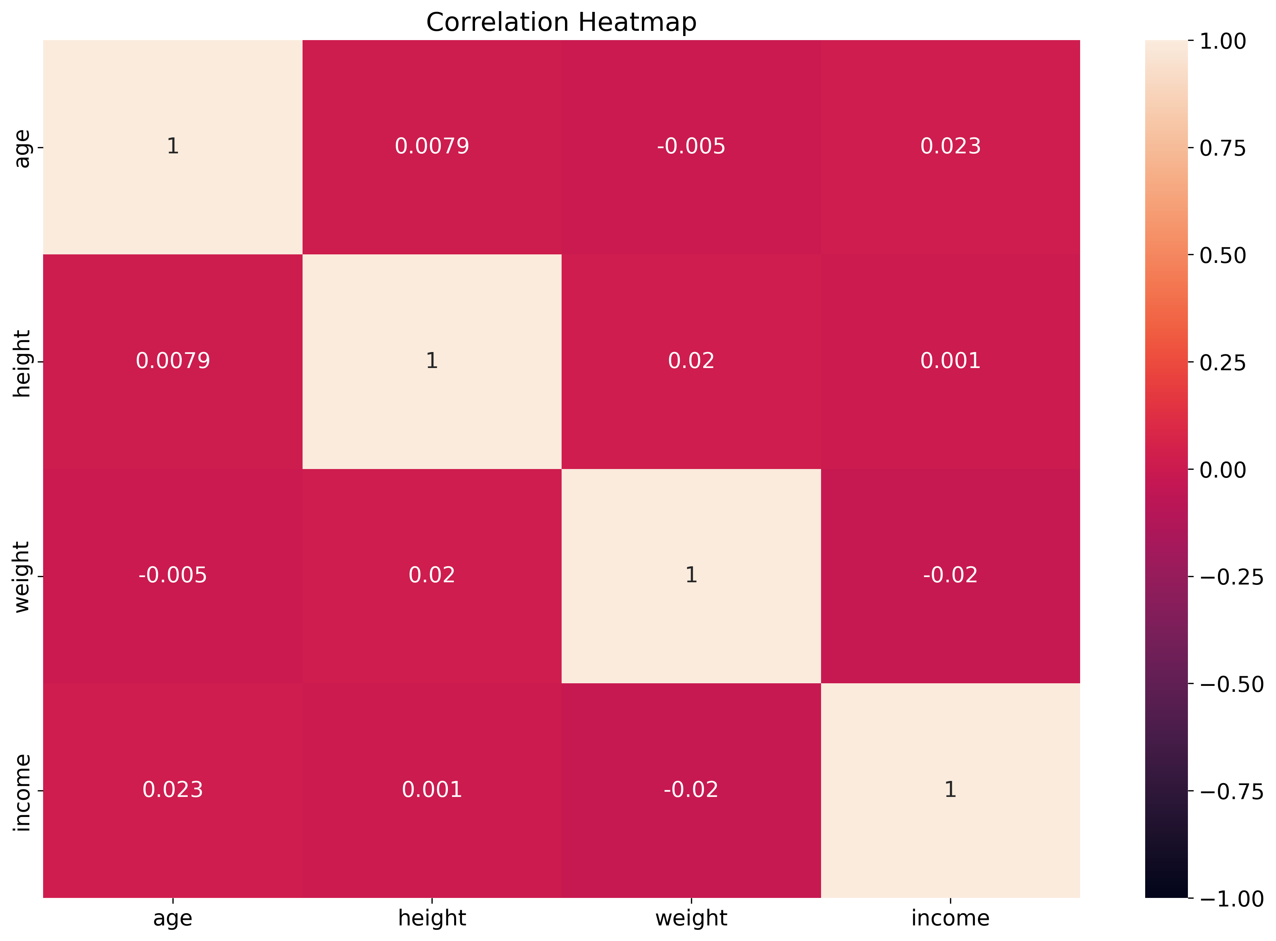
Pearson-Correlation matrix

Slide 16
Inferential Statistics

Slide 17
inferential Statistics
T-test to see if there is a significant difference in Income between Male and Female

Slide 18
Final considerations

Slide 19
Final considerations
Final questions | Reason | Objective | Test done?
Normal distributions for the variables reason | Having Dataset normalized | Using Numpy to generate random datasets | YES
Descriptive statistics insights | Verify Datasets Requirements | Verify if computed values, for mean, variance, ecc. are correct | YES
Boxplots interpretation, about outliers | N. of outliers very small | Result Expected within gaussain distributions | YES
Correlation Matrix | correlations between data columns | No correlation found | YES
T-test results | The p-value shows the likelihood of your data occurring under the null hypothesis | P-value almost equal to 1, i.e. no income differenceses | YES

Slide 20
Thank you
Carlo Bloch

